Slide 1
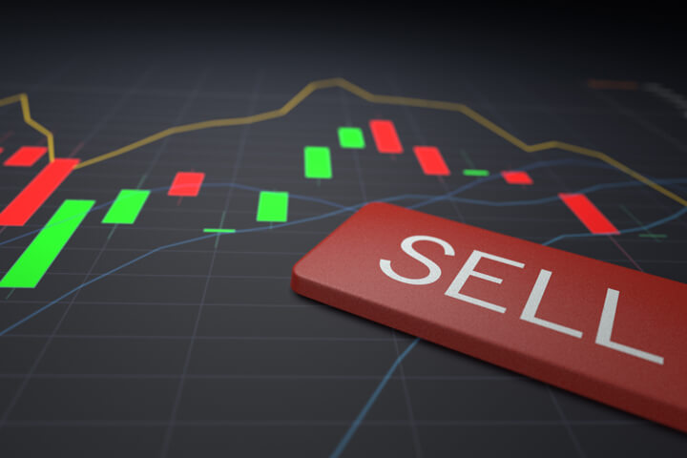
Candlesticks 101
How To Understand the Characteristics of Candlesticks on Charts

Slide 2
General Disclosure Statement
OLD MIDDIES INVESTMENTS, LLC is not a Broker Dealer. OLDMIDDIES INVESTMENTS, LLC provides basic financial literacy and engages in the education of trading and investing in all asset classes.
The information provided is for educational purposes only. This information neither is, nor should be construed, as an offer, or a solicitation of an offer, to buy or sell
securities, commodities, or currencies. You shall be fully responsible for any financial decision you make, and such decisions will be based solely on your evaluation of your financial circumstances, investment objectives, risk tolerance, and liquidity needs.
No statement in this presentation shall be construed as investment advice; consult a licensed provider in the appropriate financial asset class.
No representation is being made that any portfolio will, or is likely to achieve profits or losses similar to those shown. All investments and trades carry risks.

Slide 3
Objectives
- Compare and contrast line charts with candlestick charts
- Understand candlestick components
- Define base candles and leg candles
- Understand the range of a candlestick
- Analyze overnight gaps within charts
- Analyze bullish and bearish candle patterns

Slide 4
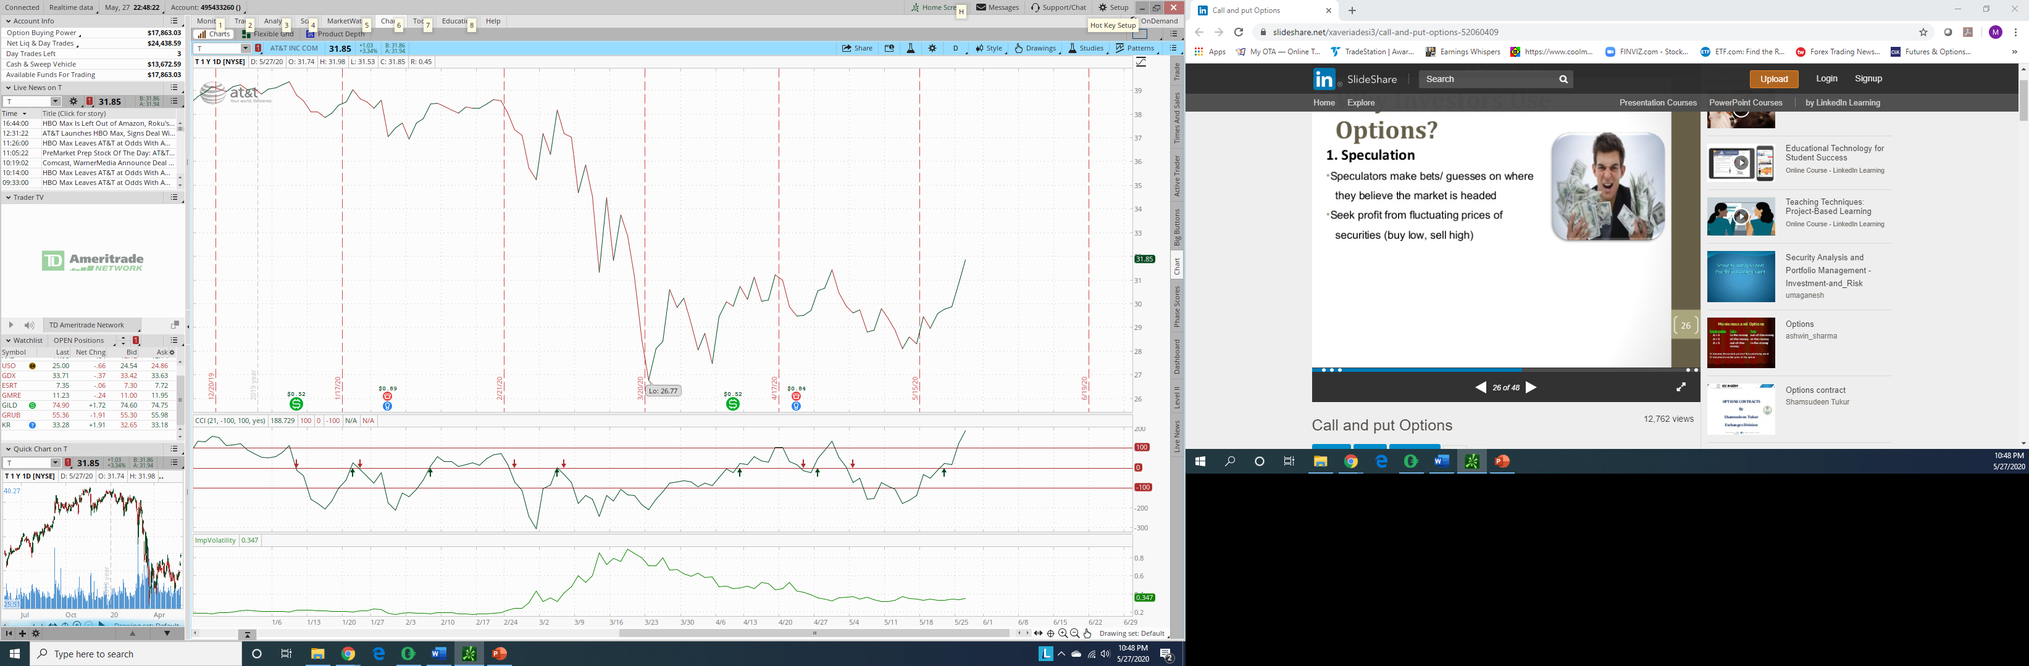
Is this how you read charts?
What information do you receive from this chart?

Slide 5
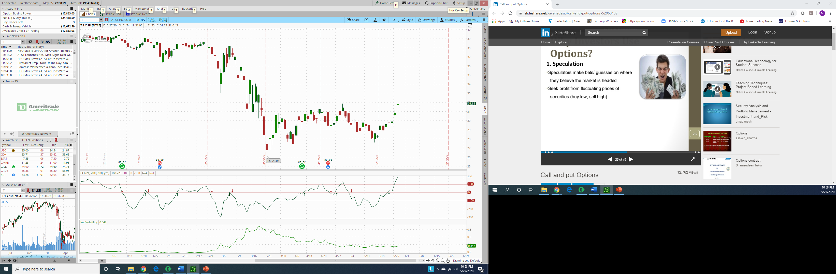
Or, is this how you read charts?
What information do you receive from this chart?
Let’s zoom in to read better

Slide 6
AT&T Chart
…and even more

Slide 7
Daily AT&T Candle
There are important pieces of information you get from an individual candle…

Slide 8
Candle Components
Bullish Candle
Bearish Candle
high
high
wick
close
open
range
body
body
open
close
low
low
Note: Each candle holds this data within a defined time period

Slide 9
Base Candles
A candle is a Base Candle if the candle body is ≤ half of its range.
A neutral candle or doji candle (neither red or green) is also a base candle:
Selling pressure
Buying pressure
Note: The longer the wick on a candle, the more buying/selling pressure within the given period

Slide 10
Leg Candles
A candle is a leg candle if the candle body is > 50% of its range.
Note: The longer the body of a candle, the more imbalance of buying/selling within the given period

Slide 11
Range of Candlestick
100%
If price closes 80% to 100% of its range, candle is Very Bullish
If price closes 60% to 80% of its range, candle is Bullish
If price closes 40% to 60% of its range, candle is Neutral
If price closes 20% to 40% of its range, candle is Bearish
If price closes 0% to 20% of its range, candle is Very Bearish
80%
60%
40%
20%
0%

Slide 12
AT&T Overnight Gap Up
What is going on in this gap?

Slide 13
Bullish Candles and Patterns
R or G candle
Hammer candle
Bullish Harami
Morning star pattern
R or G candle
Bullish engulfing pattern

Slide 14
Bearish Candles and Patterns
Hammer candle *
Evening star pattern
Bearish Harami
Bearish engulfing pattern
Shooting star

Slide 15
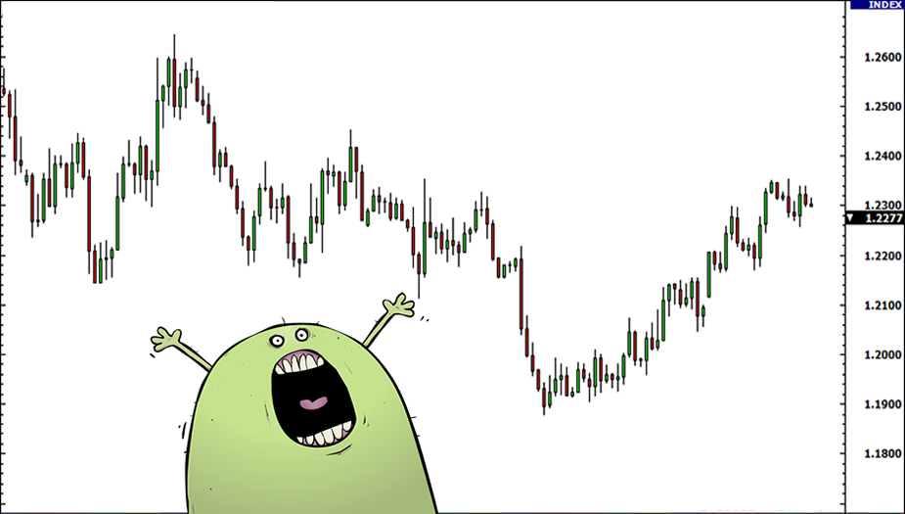
Do I buy or sell?

