Slide 1

Estate Planning 101

Slide 2

Why should you have an Estate Plan?
“If you have some assets
(maybe just a car and
some nice furniture)
or minor children,
you still need an estate plan--
even if taxes are not an issue.”
- Smart Money Magazine (January 2012)*
* http://www.smartmoney.com/retirement/estate-planning/why-most-people-need-an-estate-plan-1300823957136/
Notes:
Most people should have an estate plan for what happens to their assets after they die.

Slide 3

56% of Americans do not have any estate planning documents in place*
* 2011 National Survey by LexisNexis

Slide 4

Only 23% of American adults over age 50 have a trust*
* AARP Poll

Slide 5


Why don’t more people have an estate plan?
Intimidating process
Attorney costs
Uncomfortable topic
Too complicated

Slide 6


However at the end of the day -everyone has an Estate Plan
Your plan
Government’s
plan
Notes:
If you don’t make your own plan, government will make those decisions for you.

Slide 7

Your choice – two options
or
Two questions:
  Who makes decisions over your assets, your healthcare, your family’s future, etc.
  You or the government?
  How much of your estate do you want to be paid to courts and lawyers?
Notes:
If you don’t make your own plan, government will make those decisions for you.

Slide 8




No Estate Plan = Probate
Assets
Your Heirs
Probate Court
Courts decide who receives your assets
Your private matters are public record
Family waits months (or years) before receiving assets
Notes:
6+ months. 1 reason probate takes time because most states have minimum periods of time that creditors are allowed to respond.
No documents or will: give up decision making to court system and pay a lot of money to attorneys.
If you don’t handle your affairs, the government and expensive lawyers will do it for you; and that will likely mean your family will get a lot less of you’re the assets your worked hard for your entire life;

Slide 9
No Estate Plan = Probate
Assets
Your Heirs
Probate Court
Average Probate can take 12 months
Multiple probates if assets in 2+ states
Thousands of dollars in costs and fees
Notes:
6+ months. 1 reason probate takes time because most states have minimum periods of time that creditors are allowed to respond.
No documents or will: give up decision making to court system and pay a lot of money to attorneys.
If you don’t handle your affairs, the government and expensive lawyers will do it for you; and that will likely mean your family will get a lot less of you’re the assets your worked hard for your entire life;

Slide 10

Costs of Probate
Filing fees examples
  CA: $395; FL: $400; ID $223-$300
Legal notice fees
Bond fees
Personal representative fees
Attorneys fees
Appraisal fees

Slide 11
Average Cost of Probate
Range: 1% to 8% of estate
$300,000 estate: $3,000 to $24,000
California: $100,000 estate can cost $8,000+
Under some state laws, the attorney and personal representative are entitled to “reasonable compensation”
Typical average probate is $2,000-$5,000
PLUS Time: Six months to over a year
PLUS Loss of privacy

Slide 12



Benefits of Avoiding Probate
Save money
Save time
Save Stress (& Paperwork)
Privacy for your family
Notes:
A will does not provide these benefits
Money goes to your family without taking out a big chunk to courts or attorneys

Slide 13
How does a Living Trust eliminate Probate Court?
Assets
Your Heirs
Probate Court
Revocable Living Trust
A Living Trust is a contract!
Creating a separate entity that will outlive you & eliminate the need for the court.

Slide 14
What is a Revocable Living Trust?
Legal document that creates a new entity
Fund your assets into the trust
You own and control the trust while alive
  Move assets in and out of the trust
Specify what happens to assets after you die
Revocable and changeable while alive
Notes:
What happens to assets: who manages assets, who distributes them, who receives them
Own and control: you are the trustee and beneficiary
Continue to do what you’ve always done, and you can move assets into and out of the trust

Slide 15
You Decide - Not a Court
Who receives your hard earned assets
When they receive them (at what age)
How they receive them (over time; lump sum)
Who makes decisions if you are incapacitated
Who manages assets for minors
Who raises your children
Notes:
Decisions if you are incapacitated: involving financial matters, involving healthcare matters, whether you want to be placed on life support systems if you are terminally ill
You control decisions that affect you, you health, your assets and your family…not a court or attorneys

Slide 16
A Comprehensive Estate Plan Includes:
Revocable Living Trust
Last Will & Testament (Pour-Over Will)
Durable Powers of Attorney
Advanced Medical Directives

Slide 17

Last Will and Testament
Last Will and Testament is often called a Pour-Over Will.
It is used in conjunction with a Revocable Living Trust to convey anything you have forgotten to fund into the trust prior to your death (hence "pour-over").
Any un-funded assets will go through probate first, (unless they are minimal in value).

Slide 18
Powers of Attorney
Two Main Durable Powers of Attorney:
  For Finances
  For Healthcare
"Durable" means that the appointment of the power will "endure" even after your incapacitation.
This power is effective either upon the date of execution of the document or upon your incapacitation depending on the selection you make in the document.

Slide 19
Powers of Attorney
The Durable Power of Attorney for Finances will give your appointed agent the power to make basic financial decisions regarding assets NOT FUNDED into your Trust.
For assets already funded into the Trust, the Trustee already has this authority.
Your agent may use this power to buy and sell non-trust assets, write checks from your (non-trust) accounts etc... He or she could even fund assets into your Trust prior to your death to avoid probate.

Slide 20
Powers of Attorney
The Durable Power of Attorney for Health Care allows your appointed agent to make important health care decisions for you in the event of your incapacitation.
Choose carefully because your agent can terminate life support systems even if the principal is not "terminally" ill.

Slide 21

Living Will & Advance Directives
Living Will and Advance Directives allow you to determine how you want medical care administered if you have a terminal illness or are in a comatose state.
If such a condition should happen to you, these instruments will serve to give notice to medical professionals your wishes.

Slide 22
How about a Last Will & Testament?
Good question! Much better than having nothing. But, it is a “wish document” and passes through the Government’s Probate Court.

Slide 23

So what’s the solution:

Slide 24

The solution:
An online-based Estate Planning Technology

Slide 25
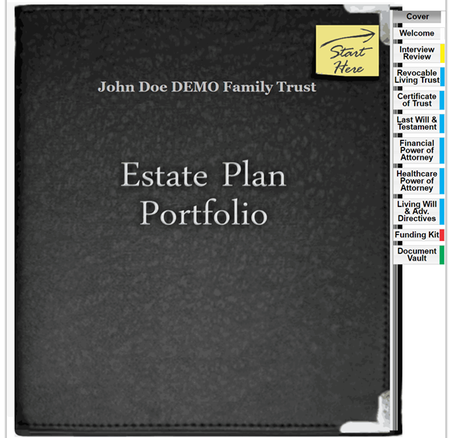
The process is simple

Slide 26

Easy: Online platform walks your clients through the process
Educational: Online videos and printed guides
Notes:
Flexible: circumstances change…divorce, beneficiary dies, add beneficiary or other changes in your life

Slide 27
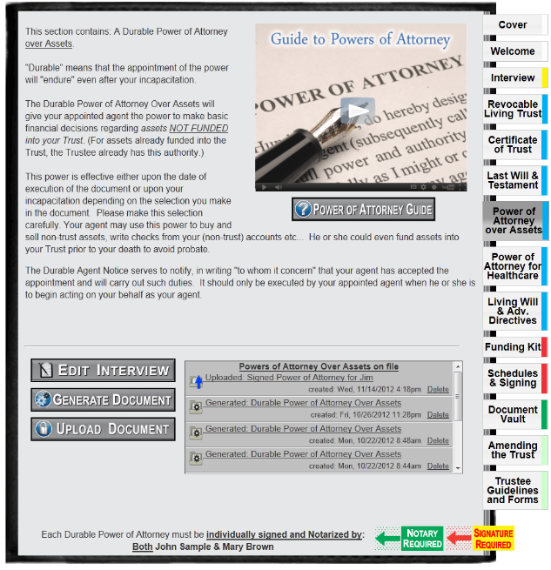
Secure Document Vault: Store signed copies of all your documents. 24/7 access.
Notes:
Flexible: circumstances change…divorce, beneficiary dies, add beneficiary or other changes in your life

Slide 28
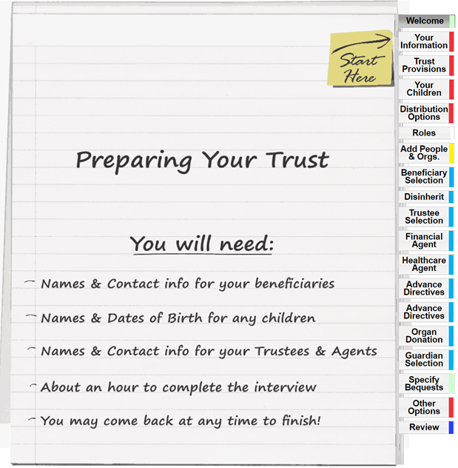
Simple: Online platform walks clients through the process
Fast: Can create documents in about an hour
Notes:
Flexible: circumstances change…divorce, beneficiary dies, add beneficiary or other changes in your life

Slide 29



What About Special Needs?

Slide 30
Special Needs Provisions
Included in all Trusts!
Language to create a special needs sub-trust is
included in every plan!

Slide 31
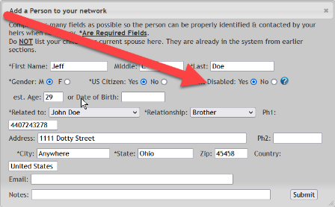
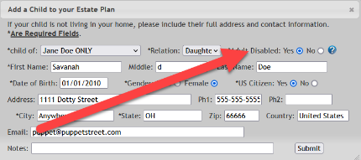
Just Click Disabled & the beneficiary will be included in the Special Needs Sub-Trust

Slide 32
Caring for Special Needs is What Matters
The successor trustee will make sure the child is cared for, providing health, maintenance, education and support.
They live off the trust you set up.

Slide 33
Special Needs Beneficiaries are Protected
Beneficiaries will never receive a lump sum.
They will receive ‘income only’ from the trust.
So Gov’t benefits will
NOT be jeopardized.

Slide 34
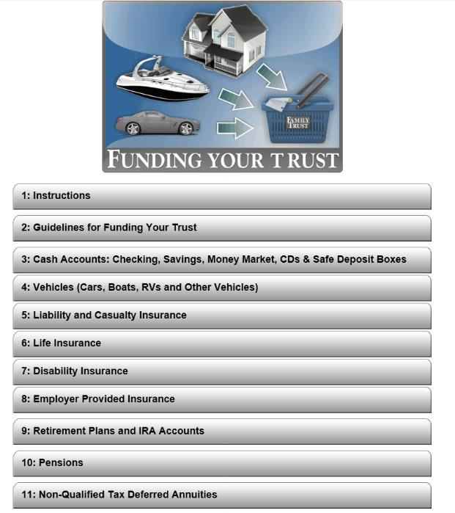
Online Funding Kit: Patent pending system to track assets and funding for clients.
Notes:
Flexible: circumstances change…divorce, beneficiary dies, add beneficiary or other changes in your life

Slide 35
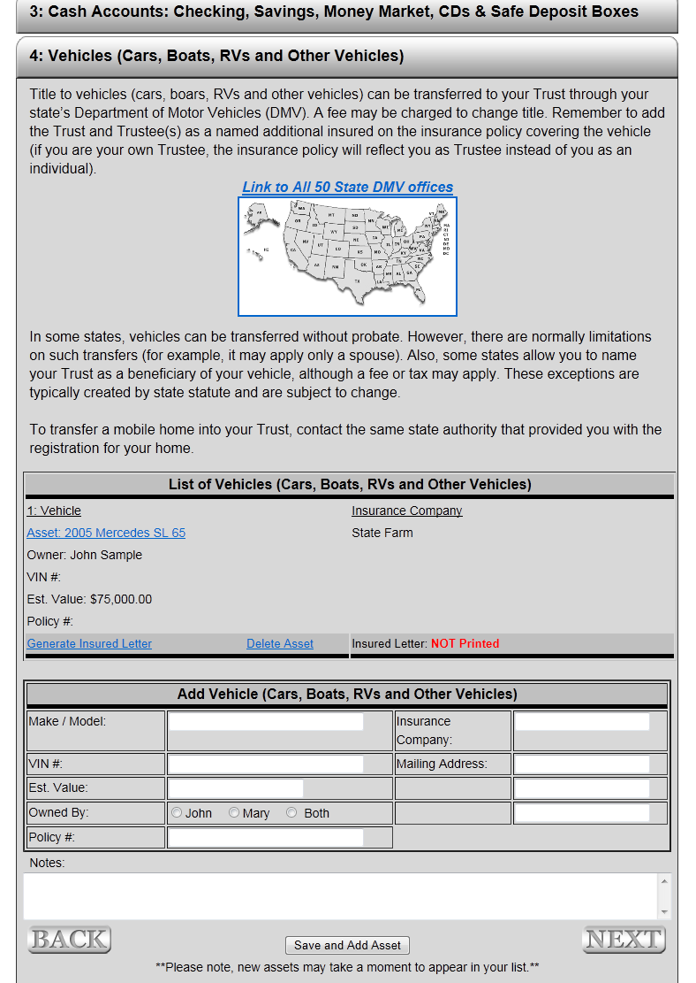
Online Funding Kit: Patent pending system to track assets and funding for clients.
Notes:
Flexible: circumstances change…divorce, beneficiary dies, add beneficiary or other changes in your life

Slide 36
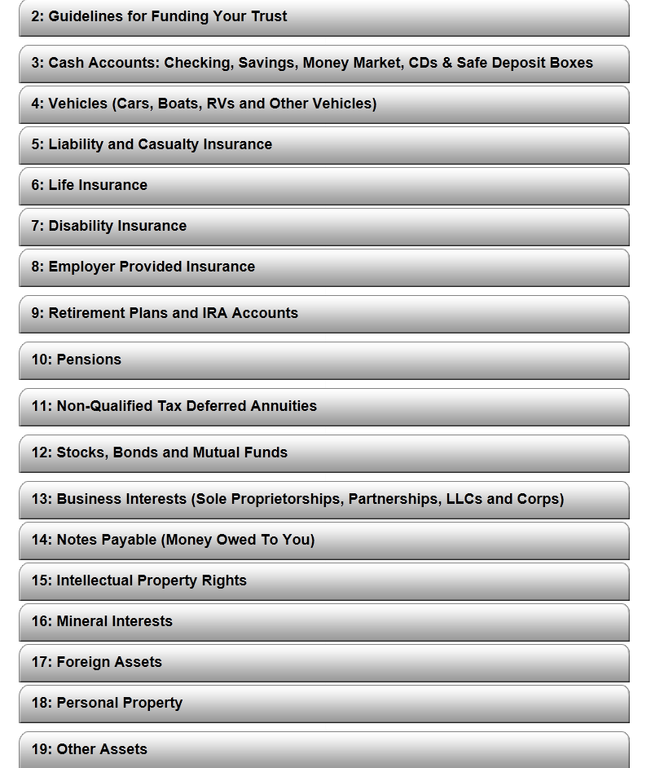
Online Funding Kit: Patent pending system to track assets and funding for clients.
Notes:
Flexible: circumstances change…divorce, beneficiary dies, add beneficiary or other changes in your life

Slide 37
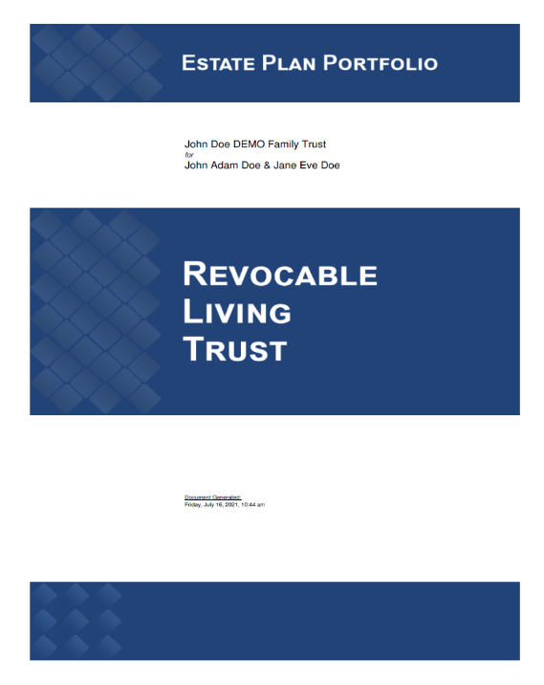
Professional
And
Complete
Peace
Of
Mind

Slide 38
Click Below
Start Your Estate Planning NOW!

